Slide 1
Enhanced Sub-6 GHz Microstrip Patch Antenna with Wideband for Next-Gen Wireless Systems U20EC706 PROJECT PHASE I
PRESENTED BY
MANOJKUMAR .S (810422106062)
RAJASURYA .J (810422106090)
SELVAKRISHNAN .K (810422106104)
SIVAPRADHOSH .U (810422106109)
GUIDED BY
Mr. N.KHADAR BASHA, M.E.,
Assistant Professor,
Department of Electronics and Communication Engineering.

Slide 2

Contents
Abstract
Introduction
Existing System
Literature Survey
Proposed System
Software Used
Results
Applications
Conclusion
References

Slide 3
Abstract
This work focuses on designing an efficient 3.7 GHz microstrip patch antenna using ANSYS HFSS for Sub-6-GHz communication.
The design aims to achieve wider bandwidth, improved gain, and stable radiation characteristics suitable for modern 5G systems.
An FR-4 substrate with a thickness of 1.6 mm is used to enhance the antenna’s overall performance.
The antenna structure is optimized to maintain compact size while providing effective suppression of unwanted frequency components.
Simulation results demonstrate good return loss, strong radiation behavior, and wide impedance bandwidth, making the antenna suitable for 5G, WiMAX, IoT, and general wireless communication.

Slide 4
Introduction
Today’s wireless devices need antennas to send and receive signals.
The 3.7 GHz band is widely used in 5G and modern communication.
Normal antennas at this frequency often have limited bandwidth and may face signal losses.
So, we designed a better microstrip patch antenna using HFSS.
The goal is to get higher bandwidth, better signal strength, and less unwanted frequency interference.
Our design uses an FR4 substrate with a 1.6 mm thickness to improve performance.
The antenna is suitable for 5G, WiMAX, IoT, and Sub-6-GHz applications.

Slide 5
Existing System
The existing antenna design from the base paper uses an FR4 substrate with 0.8 mm thickness.
It resonates around 3.54 GHz with a –10 dB bandwidth of about 400 MHz (3.35–3.75 GHz).
The achieved realized gain is 2.11 dB, and the directivity is 3.10 dB.
The return loss is –32.87 dB, indicating good matching, but the bandwidth remains limited.
The antenna does not include filtering behavior, so it cannot suppress unwanted higher-order frequencies.
Overall, the existing system works, but it does not meet modern wireless requirements, such as wide bandwidth and high signal quality needed for 5G mid-band.

Slide 6
Literature Survey
S.No. | Author / Year | Title of the Paper | Components Used | Techniques Used | Drawback
1 | Li et al., 2024 | T-Shaped Strips Loaded Filtering Patch Antenna | Patch + T-strips | Transmission-zero creation | Moderate bandwidth
2 | Chen et al., 2022 | Wideband Filtering Antenna With Multipath Coupling | Patch + resonators | Multi-path coupling | Difficult tuning
3 | Renwarin et al., 2024 | Triangular Patch Antenna With Harmonic Suppression | Triangular patch + arc slots | Slot-loaded harmonic cancellation | Limited gain
4 | Bicer & Aydin, 2024 | Compact ETMPA Analysis Using GPR Model | Triangular patch | ML-based optimization | High computation load
5 | Saeed et al., 2024 | Microstrip Antenna for Sub-6-GHz 5G Applications | Patch with slots | Slot shaping | Narrow filtering effect
6 | Gnanalakshmi et al., 2024 | Sierpinski Fractal Microstrip Antenna | Fractal patch | Fractal geometry iteration | Low gain (<1 dB)
7 | Pan et al., 2022 | Compact Slot-Loaded Patch for 3.5 GHz | Patch + U/G-slots | Slot loading | No sharp filtering
8 | Kumar et al., 2024 | Multiband Triangular Patch With V-Slots | Triangular patch + V-slots | Multi-resonance | Complex geometry
9 | Lee et al., 2023 | Compact Sub-6-GHz Filtering Radiator | Patch + notches | Resonance control | Reduced radiation efficiency
10 | Xu et al., 2023 | Single-Layer SIW-Integrated Filtering Antenna | Patch + SIW | SIW cavity coupling | Slightly higher fabrication complexity

Slide 7
Proposed System
The proposed system introduces an improved 3.7 GHz filtering microstrip patch antenna designed using ANSYS HFSS.
The antenna uses an FR4 substrate (εr = 4.3) with increased thickness of 1.6 mm to enhance performance.
A filtering-based radiator structure is included inside the patch to naturally remove unwanted frequencies without using extra filter circuits.
The improved design provides:
Wide –10 dB bandwidth (~950 MHz, 3.30–4.25 GHz)
Better realized gain (~3 dB)
Improved directivity (3.33 dB)
The antenna maintains a compact, low-cost, single-layer design, suitable for real 5G devices.
HFSS simulations confirm good return loss (–17.1 dB), strong radiation, and stable performance in the 5G n78 band (3.3–3.8 GHz).
The proposed system is designed to perform better than the older 0.8 mm design by offering better bandwidth, higher gain, and clean filtering behavior.

Slide 8
Software Used
ANSYS HFSS (High Frequency Structure Simulator)
HFSS is a professional electromagnetic simulation software used to design antennas and RF components.
It helps us model, test, and analyze the antenna before real fabrication.
The software provides accurate results for:
Return loss (S₁₁)
Gain and directivity
Radiation pattern
Bandwidth
Electric & magnetic field distributions
It uses 3D EM simulation to show how the antenna behaves in real-world conditions.
HFSS allows parameter adjustments easily, helping us optimize our design quickly

Slide 9
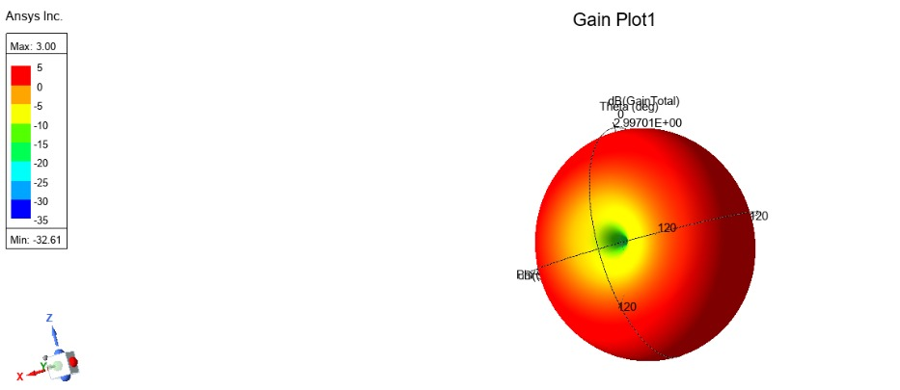
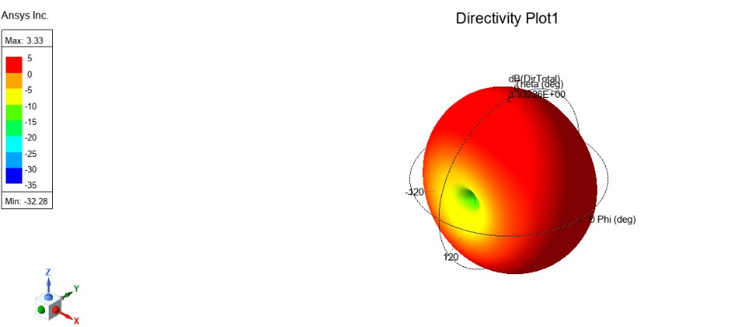
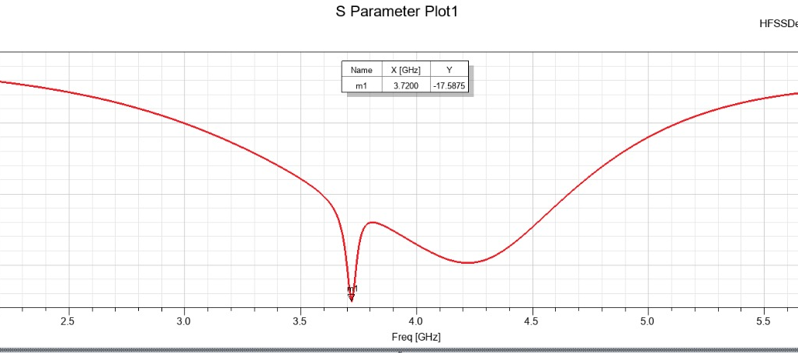
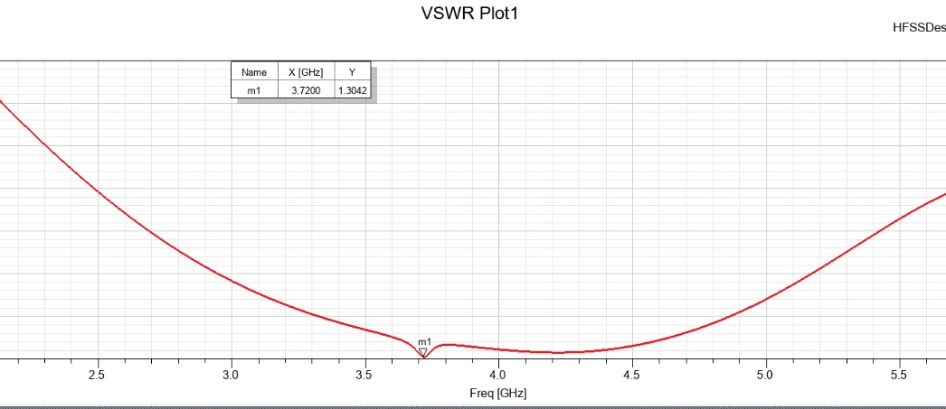
Results
Gain
Directivity
S Parameter
VSWR

Slide 10
Applications
5G Mid-Band Communication (n78 Band)
The antenna operates around 3.7 GHz with a wide 950 MHz bandwidth, making it suitable for Sub-6-GHz 5G systems such as small cells, signal boosters, and CPE units.
Broadband & WiMAX Wireless Systems
Supports 3.5 GHz wireless broadband networks used for home, office, and rural Internet connectivity.
IoT and Smart City Devices
Can be integrated into IoT hubs, industrial sensors, smart meters, and other mid-band communication devices.
Drone and UAV Communication Links
Its compact and lightweight design makes it ideal for drone telemetry, control links, and short-range aerial communication.
Short-Range Radar & Monitoring Systems
Useful for applications like traffic monitoring, environmental sensing, and low-power radar modules.

Slide 11
Conclusion
The project successfully demonstrates that the performance of a microstrip patch antenna can be improved through careful design changes and simulation-based optimization. By modifying the structure and testing different parameters in HFSS, we achieved a design that operates more efficiently and is suitable for modern wireless communication needs. The work also shows the importance of simulation tools in understanding antenna behavior and reducing the need for physical prototypes.
Key Takeaways
Small design changes can significantly improve antenna performance.
HFSS helps visualize and analyze antenna behavior clearly.
The final design is simple, reliable, and ready for practical wireless use.
The project improves understanding of Sub-6-GHz communication requirements.

Slide 12
References
[1] N. K. Mohsin and D. K. Naji, “Design of a Compact Sub-6 GHz Wideband Filtering Patch Antenna Without Extra Structure,” Progress in Electromagnetics Research C, vol. 155, pp. 165–175, 2025.
[2] M. Saeed, M. J. Farhan, and A. Al-Sherbaz, “Design and Analysis of Microstrip Antenna for 5G Applications,” Journal of Engineering and Sustainable Development, vol. 28, no. 2, pp. 285–293, 2024.
[3] R. Benedikto, H. H. Ryanu, A. D. Prasetyo, and A. Munir, “Triangular Dual-Band Patch Antenna With Harmonic Frequency Suppression,” IEEE International Workshop on Antenna Technology, pp. 302–305, 2024.
[4] M. B. Bicer and E. A. Aydin, “Analyzing Equilateral Triangle Microstrip Antennas Using Gaussian Process Regression,” Multimedia Tools and Applications, vol. 83, pp. 24435–24465, 2024.
[5] V. Gnanalakshmi, G. Shobana, and G. Prema, “Design and Analysis of Microstrip Sierpinski Fractal Antenna for Wireless Applications,” International Journal of Electrical and Electronics Research, vol. 12, no. 2, pp. 535–539, 2024.

Slide 13
Thank You….

